Slide 1
Art of successful startup - AI for Social good
Vaishnavi V

Slide 2
the clear winner in the AI race so far
The stock of this company is up 167% so far in 2023

Slide 3
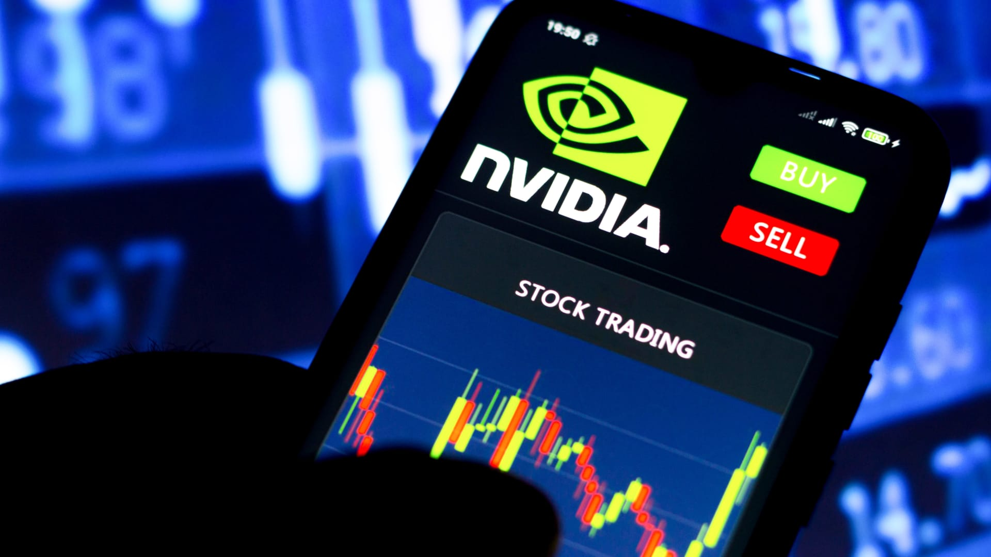
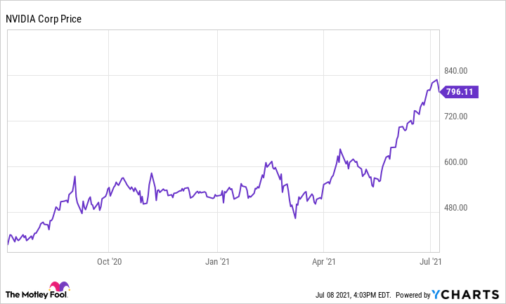
the clear winner in the AI race so far

Slide 4
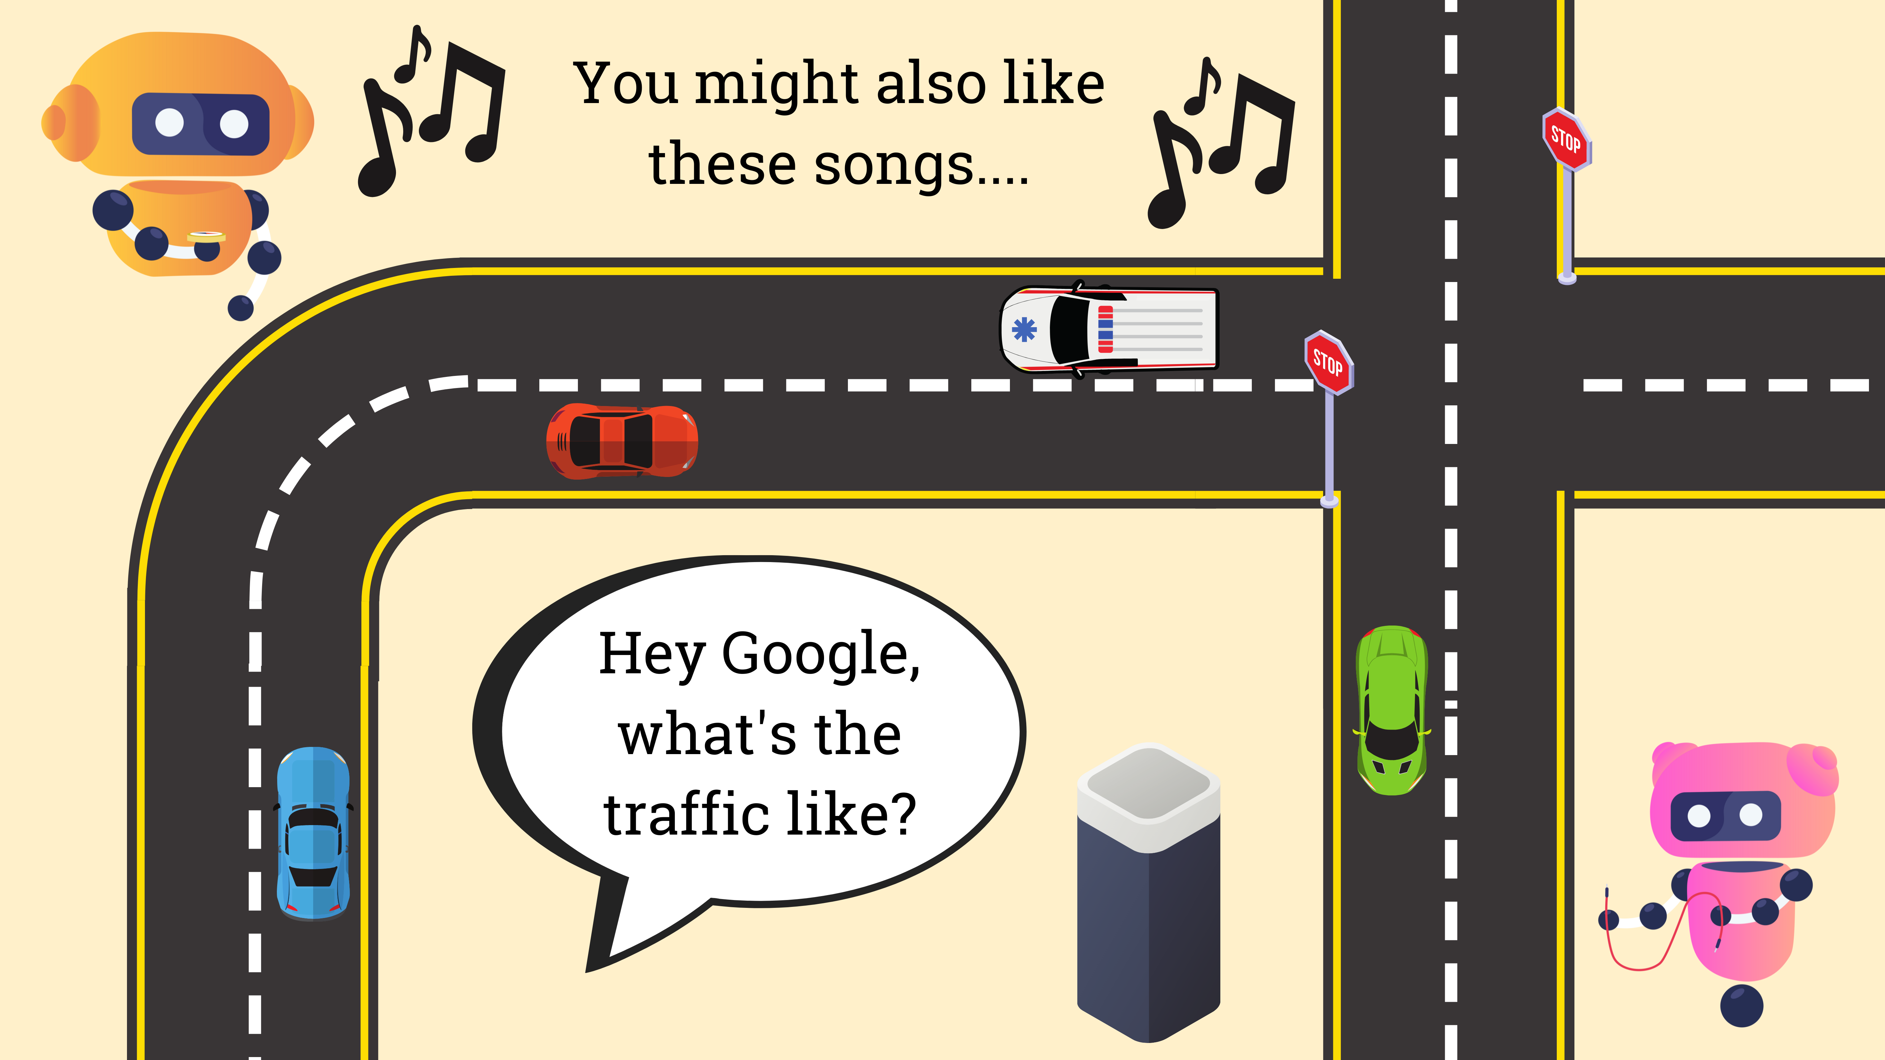

Slide 5
examples
Self-Driving Cars: Have you ever seen a self-driving car? What about a self-parking car? Autonomous vehicles are transforming mobility, using sensors to detect their surroundings.
Virtual Assistants: Hey Siri. OK Google. Alexa. Virtual assistants use natural language processing to respond to your questions and requests.
Music Recommenders: If you have ever listened to music on an app like Spotify, maybe you have noticed recommendations appear for songs you might like. That’s thanks to AI!
Source : https://www.inspiritscholars.com/blog/ai-for-social-good-projects/
Notes:
designed to be a “blueprint to achieve a better and more sustainable future for all” by 2030

Slide 6
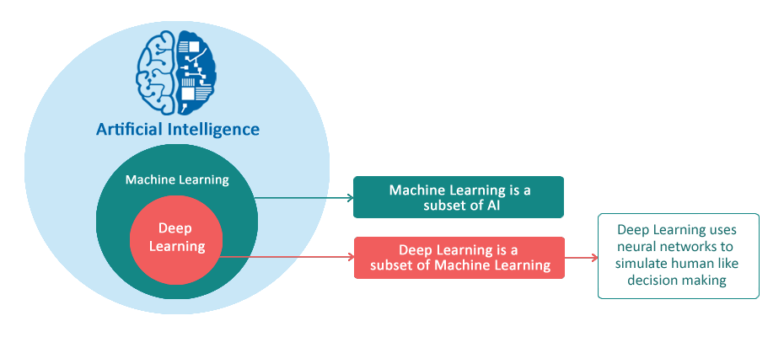
basics
Machine Learning : Machine Learning is an art of study of
algorithms and learning from examples and experience.
ML enables us to make predictions based on existing patterns in the data.
Deep Learning : Deep learning uses neural network that
comprises of different layers to learn from data.
Neural Network is an architecture where the layers
are stacked on top of each other.

Slide 7
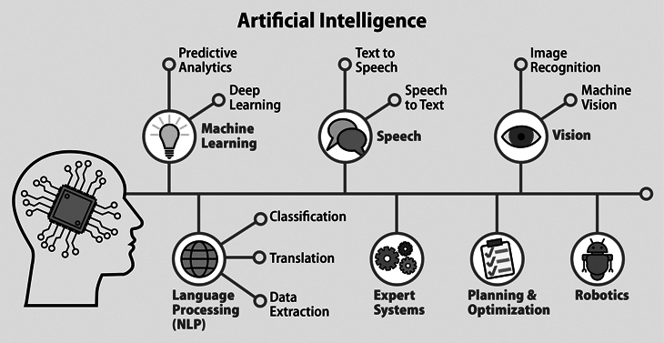
basics

Slide 8
Sustainable Development Goals
In 2015, the United Nations General Assembly announced a collection of 17 interlinked global goals, called the Sustainable Development Goals.
Its designed to be a “blueprint to achieve a better and more sustainable future for all” by 2030
These global goals encompass the majority of the world’s most pressing problems, including climate change, poverty, and access to clean water.
Notes:
designed to be a “blueprint to achieve a better and more sustainable future for all” by 2030

Slide 9


Slide 10
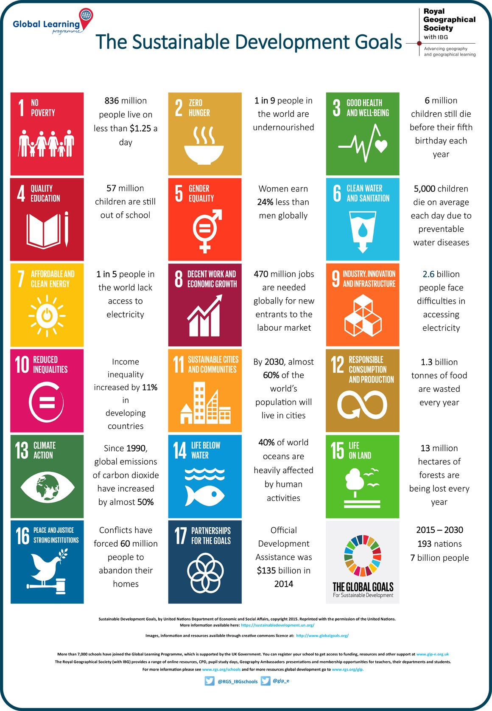
Notes:
ESG (environment, social, governance), which is now, increasingly often, replacing the older term CSR (corporate social responsibility)

Slide 11
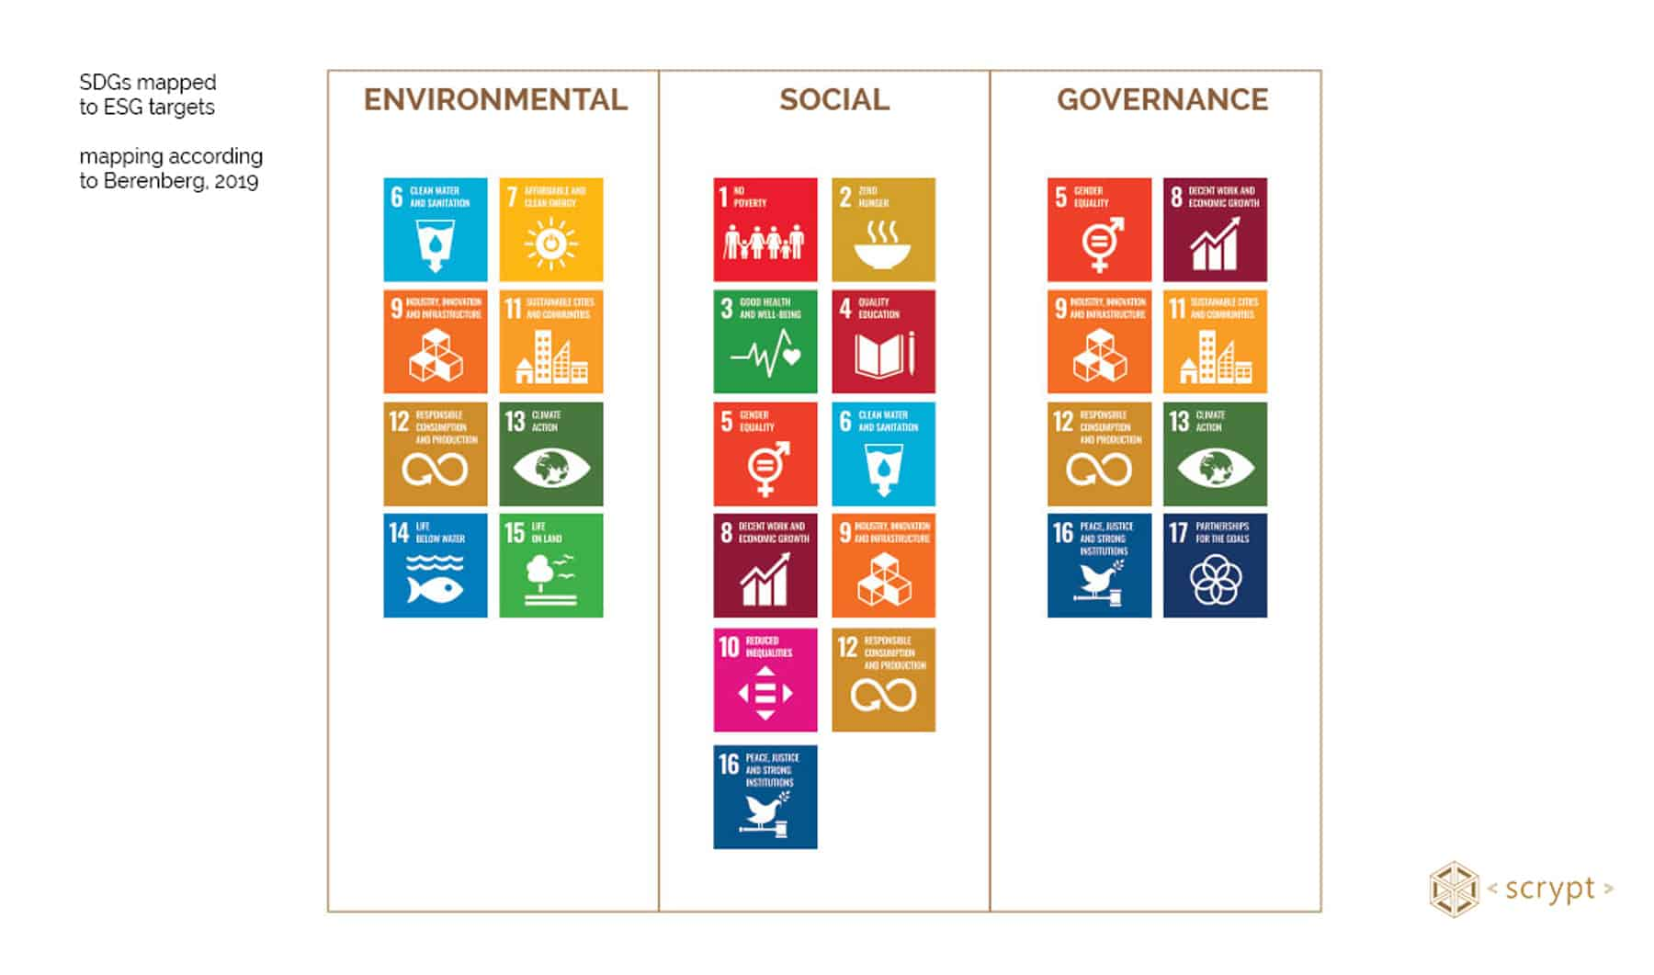
ESG Lens

Slide 12
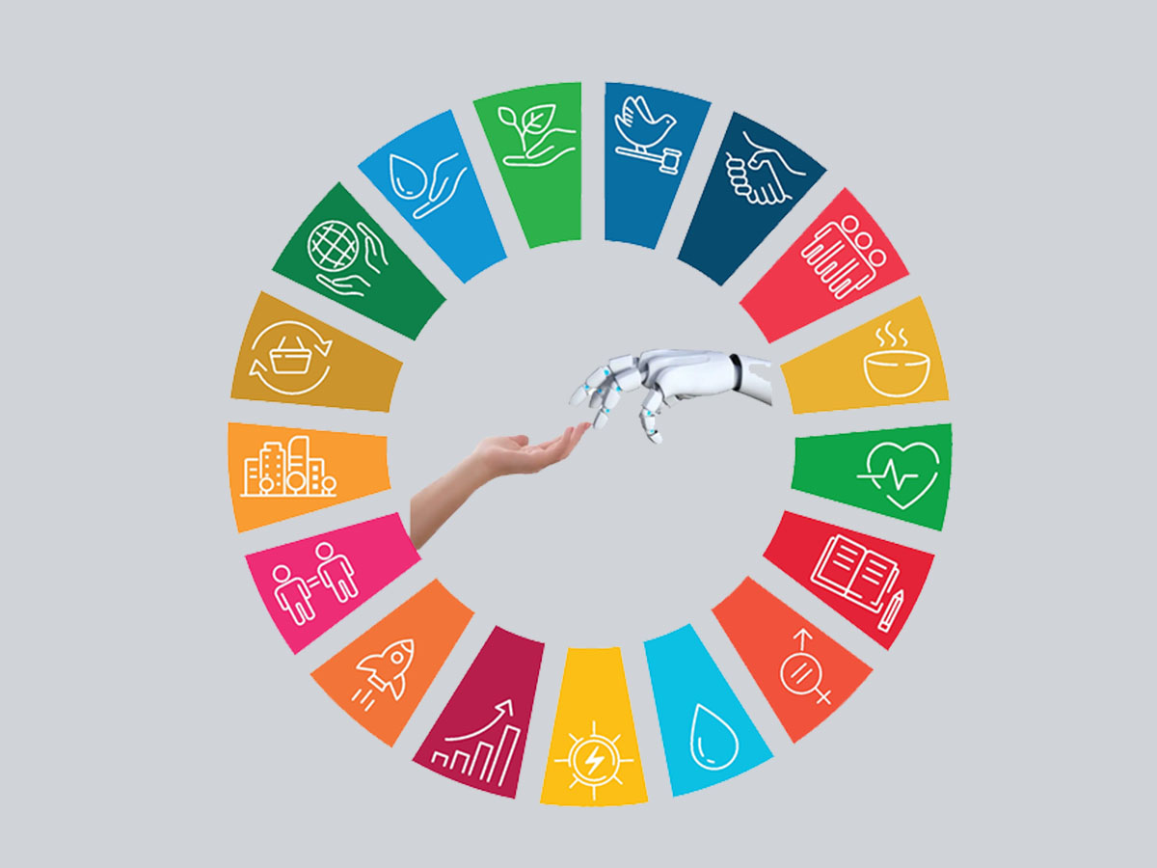
AISG

Slide 13
Good Health and Well-Being (SDG #3): Disease-detection AI system can be used to diagnose if skin lesions are cancerous.
Quality Education (SDG #4): Adaptive-learning technology can maximize student achievement by recommending content to students based on their past success (McKinsey).
Climate Action (SDG #13): AI can be used to efficiently place energy creating sources (like wind, solar, and gas) to combat climate change.

Slide 14
AI + Healthcare: With computer vision, diagnosing patients based on medical scans such as X-rays.
AI + Sustainability: Using AI to efficiently place energy creating sources (wind, solar, gas) across a country to maximize coverage.
AI + Mobility: Applying AI to create a safe and synchronized auto pilot system for cars.
AI + Ethics: Leveraging machine learning to predict returns of portfolios and create optimal combinations of assets.

Slide 15
Models
Text is the most advanced domain. However, natural language is hard to get right, and quality matters. Today, the models are decently good at generic short/medium-form writing (but even so, they are typically used for iteration or first drafts). Over time, as the models get better, we should expect to see higher quality outputs, longer-form content, and better vertical-specific tuning.
Code generation is likely to have a big impact on developer productivity in the near term as shown by GitHub CoPilot. It will also make the creative use of code more accessible to non developers.
Images are a more recent phenomenon, but they have gone viral: it’s much more fun to share generated images on Twitter than text! We are seeing the advent of image models with different aesthetic styles, and different techniques for editing and modifying generated images.

Slide 16
Models
Speech synthesis has been around for a while (hello Siri!) but consumer and enterprise applications are just getting good. For high-end applications like film and podcasts the bar is quite high for one-shot human quality speech that doesn’t sound mechanical. But just like with images, today’s models provide a starting point for further refinement or final output for utilitarian applications.
Video and 3D models are coming up the curve quickly. People are excited about these models’ potential to unlock large creative markets like cinema, gaming, VR, architecture and physical product design. The research orgs are releasing foundational 3D and video models as we speak.
Other domains: There is fundamental model R&D happening in many fields, from audio and music to biology and chemistry (generative proteins and molecules, anyone?).

Slide 17
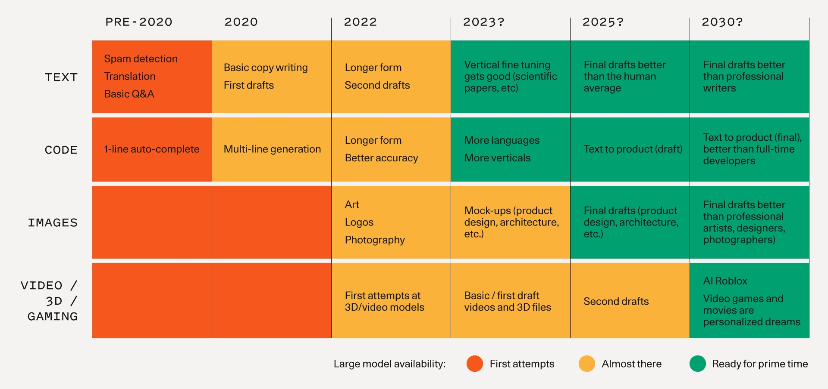
Timeline

Slide 18
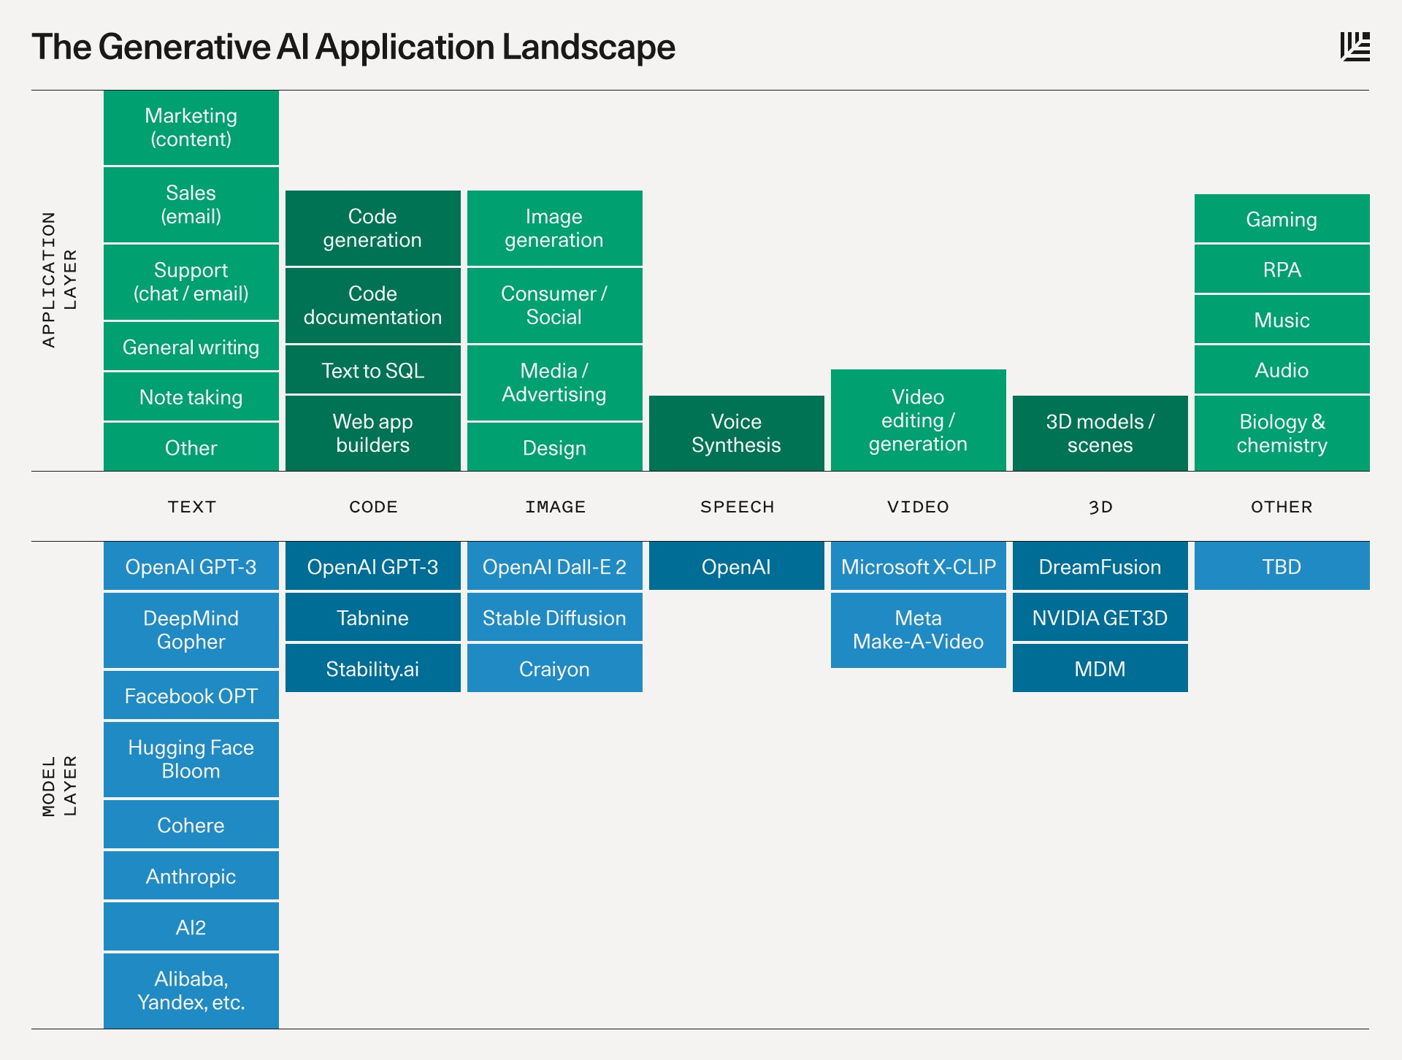
Timeline

Slide 19
Anatomy of a Generative AI Application
Intelligence and model fine-tuning
Little Brain
Generative AI apps are built on top of large models like GPT-3 or Stable Diffusion. As these applications get more user data, they can fine-tune their models to: 1) improve model quality/performance for their specific problem space and; 2) decrease model size/costs.
Generative AI apps as a UI layer and “little brain” that sits on top of the “big brain” that is the large general-purpose models
Form Factor
Paradigm of Interaction
Generative AI apps largely exist as plugins in existing software ecosystems. Code completions happen in your IDE; image generations happen in Figma or Photoshop; even Discord bots are the vessel to inject generative AI into digital/social communities.
Generative AI outputs are being used as prototypes or first drafts
Source : https://www.sequoiacap.com/article/generative-ai-a-creative-new-world/

Slide 20
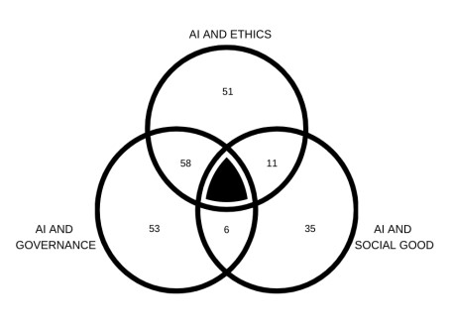
Global Partnership on AI (GPAI)
Source : https://gpai.ai/projects/responsible-ai/areas-for-future-action-in-responsible-ai.pdf

Slide 21
Global Partnership on AI (GPAI)
Ethics
Governance
Social Good
Ethical frameworks and guidelines promoting & fostering Responsible AI
Governance mechanisms operationalizing Responsible AI
Applied projects advancing SDGs responsibly

Slide 22
TRUSTED AI

Slide 23
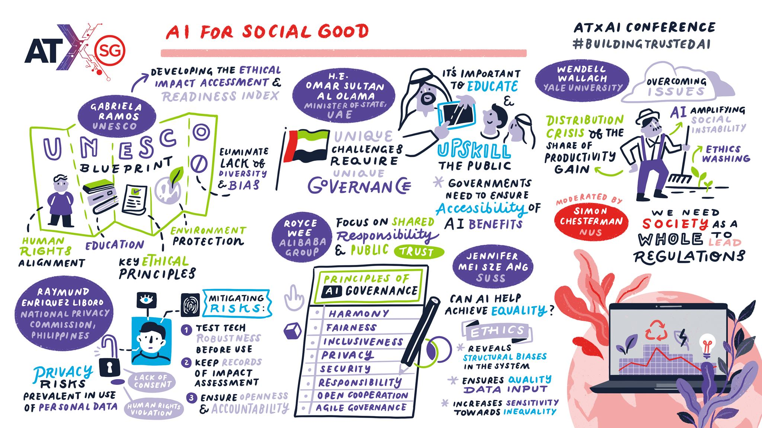
\
Notes:
Source : https://www.imda.gov.sg/resources/blog/blog-articles/2021/08/building-a-better-world-with-trustworthy-ai

Slide 24
PRODUCT OVERVIEW
UNIQUE
Only product specifically dedicated to this niche market
FIRST TO MARKET
First beautifully designed product that's both stylish and functional
TESTED
Conducted testing with college students in the area
AUTHENTIC
Designed with the help and input of experts in the field

Slide 25
PRODUCT BENEFITS
Cool and stylish product
Areas for community connections
Online store and market swap

Slide 26
BUSINESS MODEL
ABSTRACT
We based our research on market trends and social media
DESIGN
We believe people need more products specifically dedicated to this niche market
RESEARCH
Minimalist and easy to use

Slide 27
MARKET OVERVIEW
$3 Billion
$1 Billion
$2 Billion
Freedom to invent
Selectively inclusive market
Serviceable available market
Opportunity to build
Fully inclusive market
Total addressable market
Few competitors
Specifically targeted market
Serviceable obtainable market

Slide 28
Market comparison
$3B
$2B
$1B
Opportunity to build
Freedom to invent
Few competitors
Addressable market
Serviceable market
Obtainable market

Slide 29
OUR COMPETITION
CONTOSO
COMPETITORS
Our product is priced below that of other companies on the market
Design is simple and easy to use, compared to the complex designs of the competitors
Affordability is the main draw for our consumers to our product
Company A Product is more expensive
Companies B & C Product is expensive and inconvenient to use
Companies D & E Product is affordable, but inconvenient to use

Slide 30
Our competition
Convenient
Contoso
Competitor A
Affordable
Expensive
Competitor D
Competitor C
Competitor B
Competitor E
Inconvenient

Slide 31
Growth strategy
Feb 20XX
Roll out product to high profile or top-level participants to help establish the product
Mar 20XX
Release the product to the general public and monitor press release and social media accounts
Oct 20XX
Gather feedback and adjust product design as necessary

Slide 32
TRACTION
Forecasting for success
Key Metrics
 | Clients | Orders | Gross revenue | Net revenue
20XX | 10 | 1100 | $10,000 | $7,000
20XX | 20 | 200 | $20,000 | $16,000
20XX | 30 | 300 | $30,000 | $25,000
20XX | 40 | 400 | $40,000 | $30,000
REVENUE BY YEAR

Slide 33
TWO-YEAR ACTION PLAN
DRAFT BLUEPRINTS
GATHER FEEDBACK
DELIVER TO CLIENT
20XX
JAN
FEB
MAR
APR
MAY
JUN
JUL
AUG
SEP
OCT
NOV
DEC
20XX
JAN
FEB
MAR
APR
MAY
JUN
JUL
AUG
SEP
OCT
NOV
DEC
RUN FOCUS GROUPS
TEST DESIGN
LAUNCH DESIGN

Slide 35
FINANCIALS
 | Year 1 | Year 2 | Year 3
INCOME
Users | 50,000 | 400,000 | 1,600,000
Sales | 500,000 | 4,000,000 | 16,000,000
Average price per sale | 75 | 80 | 90
Revenue @ 15% | 5,625,000 | 48,000,000 | 216,000,000
GROSS PROFIT | 5,625,000 | 48,000,000 | 216,000,000
Expenses
Sales & marketing | 5,062,500 | 38,400,000 | 151,200,000 | 70%
Customer service | 1,687,500 | 9,600,000 | 21,600,000 | 10%
Product development | 562,500 | 2,400,000 | 10,800,000 | 5%
Research | 281,250 | 2,400,000 | 4,320,000 | 2%
TOTAL EXPENSES | 7,593,750 | 52,800,000 | 187,920,000

Slide 36




MEET THE TEAM
TAKUMA HAYASHI​
MIRJAM NILSSON​
FLORA BERGGREN​
RAJESH SANTOSHI​
President
Chief Executive Officer
Chief Operations Officer
VP Marketing

Slide 37
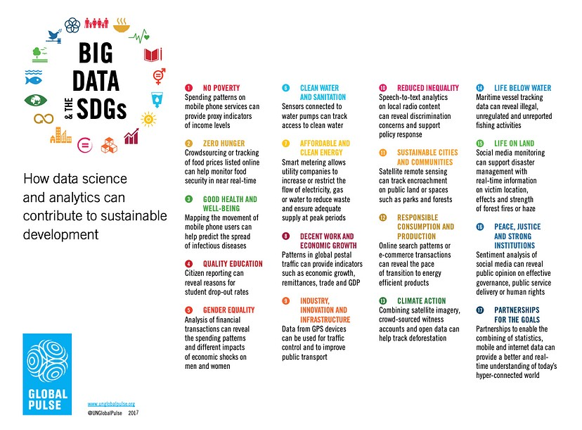

Slide 38
FUNDING
$14,000
$12,000
$82,000
$32,000
ANGEL INVESTMENTS
PROPERTY
SHARES
CASH
Amount obtained through other investors
Revenue obtained from property rentals
Number of shares converted into USD
Liquid cash we have on hand

Slide 39
SUMMARY
Data are not homogeneous; they can come from different sources and be used for different purposes. The choice of which training data to use may be competitively significant as certain attributes of training data are a better fit with specific algorithms and products than others.

Slide 40
THANK YOU
Vaishnavi V

